Slide 1
Deep Vein Thrombosis
Contemporary options for DVT Treatment
1

Slide 2
DVT and VTE Facts
Every year, there are approximately 10 million cases of Venous Thromboembolism (VTE) worldwide¹
Up to 60 percent of VTE cases occur during or after hospitalization, making it a leading preventable cause of hospital death¹
In the U.S., there are 100,000 - 300,000 VTE-related deaths every year²
In Europe, there are 544,000 VTE-related deaths every year³
In the U.S. and Europe, VTE-related events kill more people than AIDS, breast cancer, prostate cancer and motor vehicle crashes combined⁴
¹ Jha AK, Larizgoitia I, Audera-Lopez C, Prasopa-Plaisier N, Waters H, Bates DW. The global burden of unsafe medical care: analytic modeling of observational studies. BMJ Qual Saf 2013; 22;809-15. Retrieved from: http://qualitysafety.bmj.com/content/22/10/809.full.pdf+html
² US Department of Health and Human Services. Surgeon General's Call to Action to Prevent Deep Vein Thrombosis and Pulmonary Embolism 2008. Available at: http://www.surgeongeneral.gov/topics/deepvein. ³ Heit, JA. Poster 68 presented at: American Society of Hematology, 47th Annual Meeting, Atlanta, GA, December 10-13, 2005. ⁴ Cohen AT, Agnelli G, Anderson FA, et al. Venous thromboembolism (VTE) in Europe. Thromb Haemost. 2007;98:756-764.
Notes:
1 Jha AK, Larizgoitia I, Audera-Lopez C, Prasopa-Plaisier N, Waters H, Bates DW. The global burden of unsafe medical care: analytic modeling of observational studies. BMJ Qual Saf 2013; 22;809-15. Retrieved from: http://qualitysafety.bmj.com/content/22/10/809.full.pdf+html
2 US Department of Health and Human Services. Surgeon General's Call to Action to Prevent Deep Vein Thrombosis and Pulmonary Embolism 2008. Available at: http://www.surgeongeneral.gov/topics/deepvein.
3 Heit, JA. Poster 68 presented at: American Society of Hematology, 47th Annual Meeting, Atlanta, GA, December 10-13, 2005.
4 Cohen AT, Agnelli G, Anderson FA, et al. Venous thromboembolism (VTE) in Europe. Thromb Haemost. 2007;98:756-764.

Slide 3
Venous Thrombosis
Thrombus formation in the deep veins of legs or thighs
UP TO 1/3 OF DVT PATIENTS DEVELOP A PULMONARY EMBOLISM (PE)
50%+ CAN DEVELOP POST THROMBOTIC SYNDROME
DVT and PE affect 900,000 people in the U.S. every year
Source: sirweb.org

Slide 4
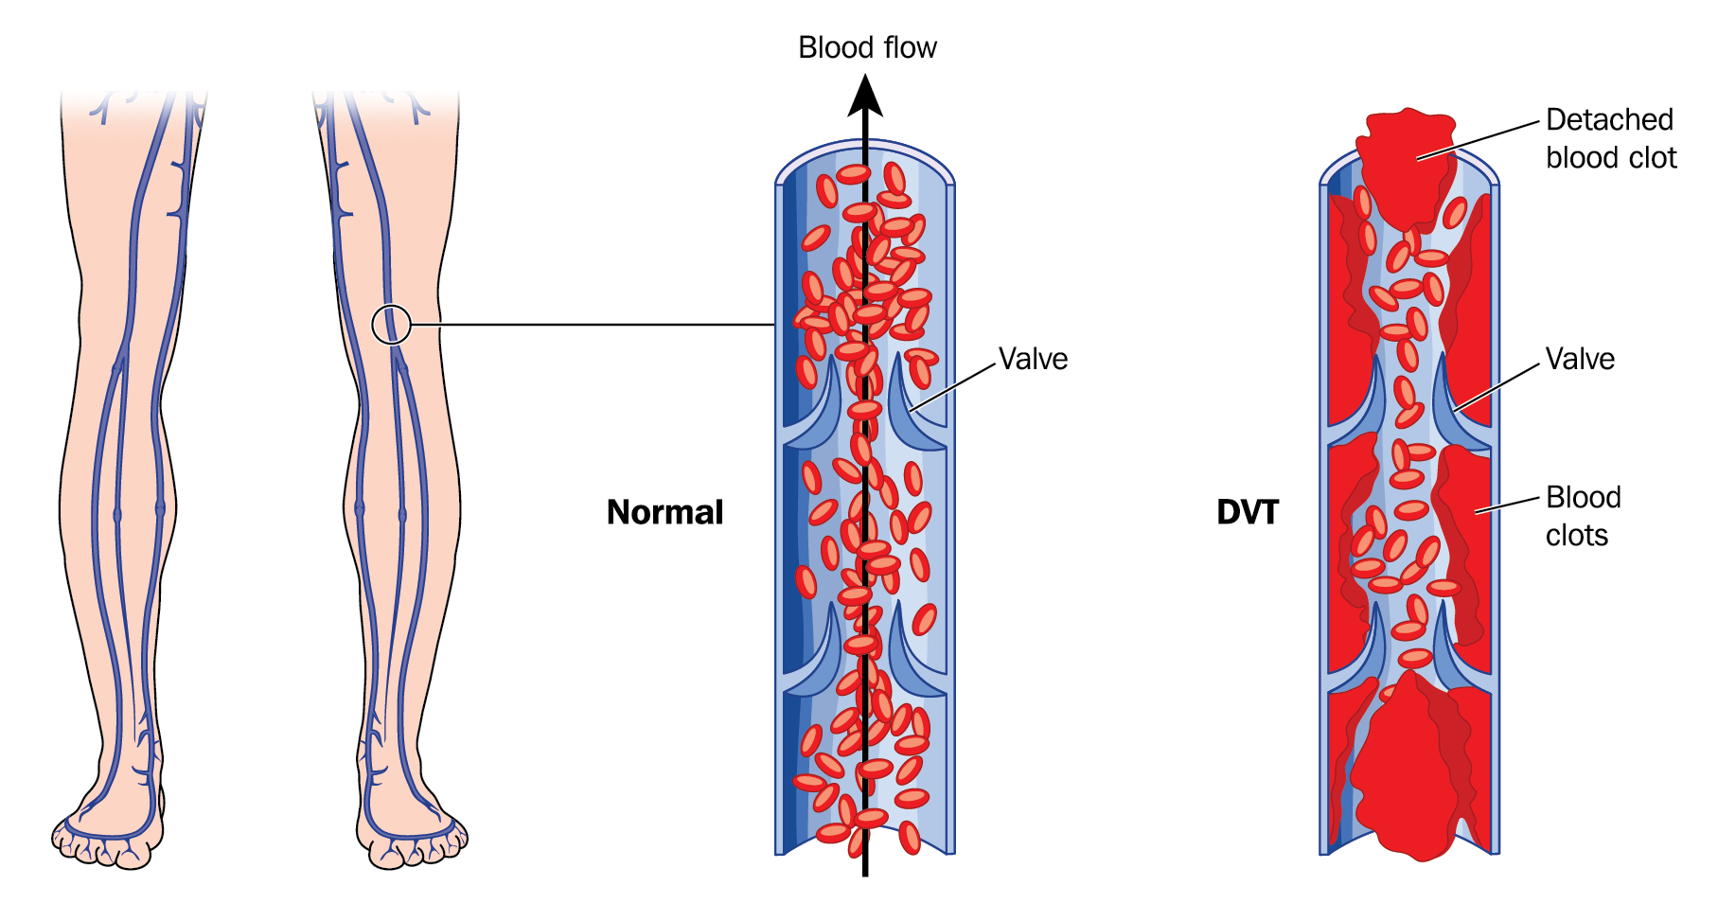
What Is Deep Vein Thrombosis (DVT)?
DVT is a blood clot that forms in a vein deep in the body
Most often occurs in the deep veins of the legs, either above or below the knee
The blood clot or part of it can break free causing pulmonary embolism (PE)
4

Slide 5
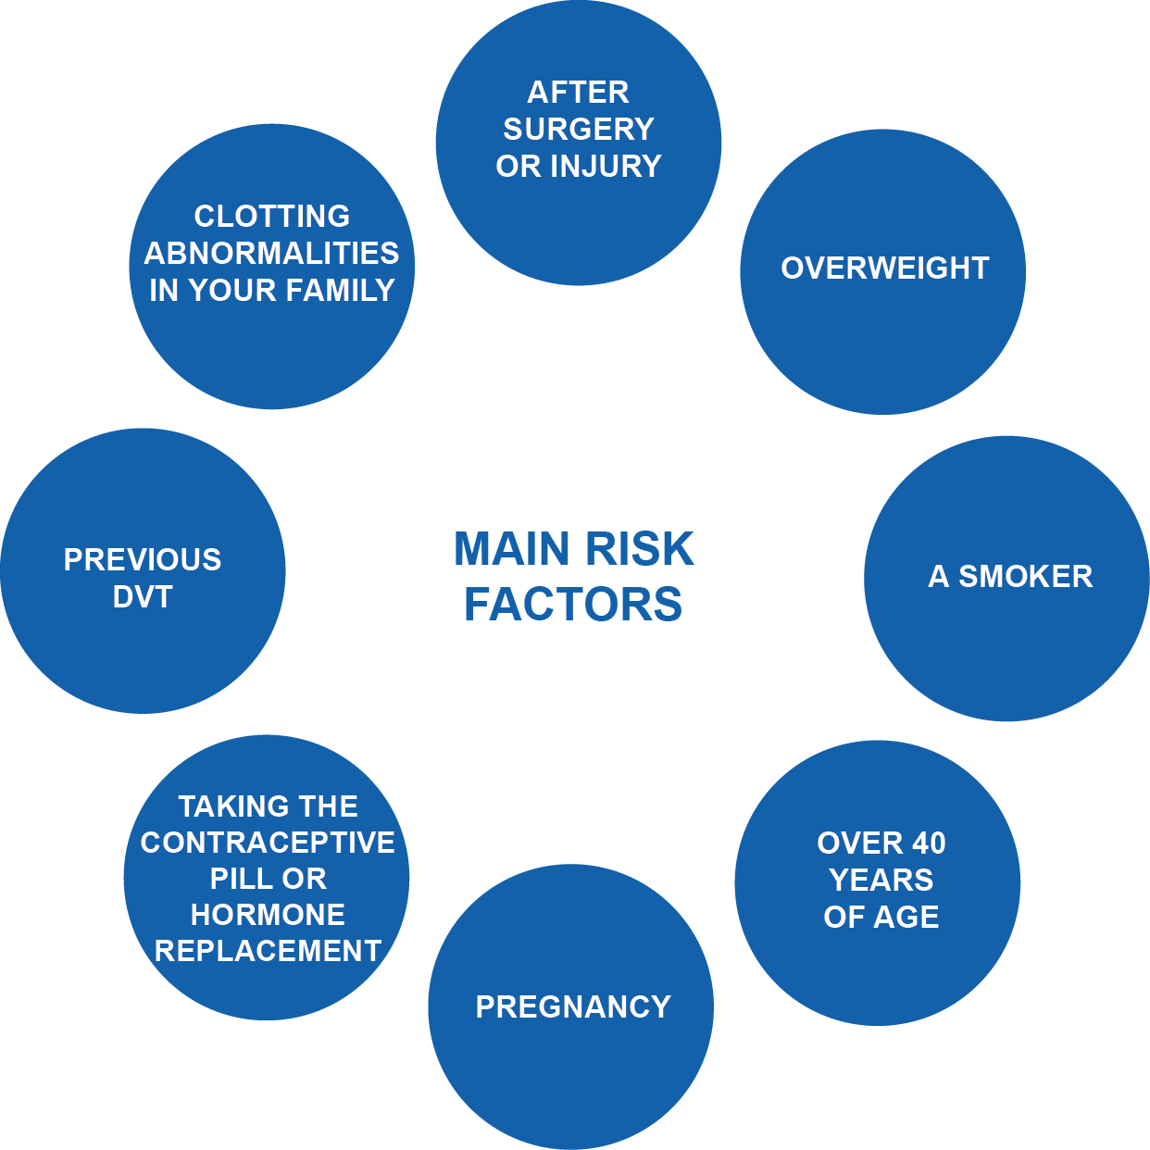
DVT: What We Know
Venous thromboembolism (VTE) is manifested clinically by deep venous thrombosis (DVT) and pulmonary embolism (PE). DVT, usually of the lower extremity, nearly always precedes PE. The risk of VTE increases after age 40.
Occurrence The disease most often occurs in hospitalized patients, particularly those with cancer or following surgical procedures, but also occurs in the general public. In both settings, multiple risk factors are usually present.
5

Slide 6
DVT Risks
Low | Moderate | High
Age > 50 years | Prior History of VTE | Acute or chronic lung disease
Myeloproliferative disorder | Impaired mobility | Obesity
Dehydration | Inflammatory bowel disease | Known thrombophilic state
CHF | Active rheumatic disease | Varicose veins/chronic stasis
Active malignancy | Sickel cell disease | Recent post-partum w/ immobility
Hormonal replacement | Estrogen-based contraceptives | Nephrotic syndrome
Moderate to Major surgery | Central venous catheter | Myocardial infarction
6
Notes:
http://www.acphospitalist.org/archives/2008/11/tool.pdf

Slide 7
DVT Risks
1
Blood clots in the deep veins can be painful and typically cause severe swelling. Multiple medications can be used for pain management and it is important to limit the swelling as much as possible.
Once a vein is blocked with clot, collateral veins need to take over the role of the blocked vein. This may cause long-term swelling of the leg, which can be uncomfortable and lead to skin changes including ulcers (this is called Post Thrombotic Syndrome or PTS).
There is a risk of blood clots breaking off, traveling to the lungs, and seriously affecting lung and heart functions. This condition is known as pulmonary embolus (PE). PE can be life-threatening and may result in death.
2
3

Slide 8
DVT: A Major Source of Mortality and Morbidity
Over 200,000 deaths per year due to PE annually in the U.S. alone.
Over 600,000
patients diagnosed with DVT annually in the US alone
Huge Costs and Morbidity
Recurrence of DVT, post-thrombotic syndrome and chronic PE / PAH are long term sequelae
More than HIV, MVAs & Breast Cancer combined
Nearly two thirds of all VTE events result from hospitalization
3
Some Causes of Death in the US | Annual Number of Deaths
PE | Up to 200,000
AIDS | 16,371
Breast Cancer | 40,580
8
Notes:
1 in 10 of the > 2 million Americans developing DVT goes on to die from pulmonary embolism (PE).
These 200,000 patient deaths represent more annual deaths than those from breast cancer, AIDS, and traffic accidents combined.
Many of these VTE deaths contribute to hospital mortality.
Pulmonary embolism is the most common preventable cause of death in the hospital; an estimated 10% of inpatient deaths are secondary to PE.
Not only do patients with VTE suffer a 30% cumulative risk for recurrence, they are also at risk for the potentially disabling post-thrombotic syndrome.
3. Heit JA, O'Fallon WM, Petterson TM, et al: Relative impact of risk factors for deep vein thrombosis and pulmonary embolism: A population-based study. Arch Intern Med 2002;162(11):1245-1248.

Slide 9
DVT Treatment Goals
Prevent pulmonary embolus
Prevent severe post-thrombotic syndrome
Prevent loss of limbs due to venous gangrene
Alleviate symptoms
With Current Treatment patterns the CDC states:
“Nearly one-third of people who have a DVT will have long-term complications caused by the damage the clot does to the valves in the vein called post-thrombotic syndrome (PTS). People with PTS have symptoms such as swelling, pain, discoloration, and in severe cases, scaling or ulcers in the affected part of the body. In some cases, the symptoms can be so severe that a person becomes disabled.”

Slide 10
The Real Question
Can we implement new treatment pathways for DVT patients thereby providing improved outcomes?
Prompt diagnosis and treatment of deep vein thrombosis (DVT) is essential to decrease both the risk of recurrence and a potentially fatal pulmonary embolism (PE)
10

Slide 11
DVT Treatment Today
Are current treatment options adequate?
Anticoagulation & Compression Stockings
Can we do better for these patients?
Using a multidisciplinary team approach
Understanding the new options for thrombus removal
Setting a goal of quickly removing the thrombus
Offering minimally invasive solutions
11

Slide 12
Treating DVT Once It Has Occurred
Interventional Treatment of DVT can help reduce the risk of complications, such as PE
The current goals in treating DVT are to:
Stop the clot from progressing and getting larger
Reduce the chance of having another clot develop
Prevent the clot from breaking off in your vein and moving to your lungs
12

Slide 13
Treating DVT Once It Has Occurred
The goal once a DVT has been diagnosed is clot removal
The options of “clot removal” are
dissolving and/or mechanical removal
Restoring flow decreases risk of clot propagation
Allows venous valves to return to normal function
Potential to decrease long term anticoagulation
13

Slide 14
A New Option For Venous Thrombus Removal
New options exist for minimally invasive treatment to remove the venous clot
Infusion of clot busting medication to assist in removal
Followed by thrombus removal using a mechanical device to remove the clot from the vessel and body
14

Slide 15
DVT Clot Removal
We Believe We Can
Efficiently remove the thrombus
Provide quick restoration of venous flow
Decrease risk of embolic complications
Assist in restoring normal venous valve function
15

Slide 16
DVT Clot Removal
Interventional Treatment Offers Patient's:
A minimally invasive procedure
Potential to minimize treatment time
Possibly eliminate or decrease dose and duration of thrombolytic
Potential for quick resolution of signs and symptoms
Improved short-term & long-term outcomes
16

Slide 17
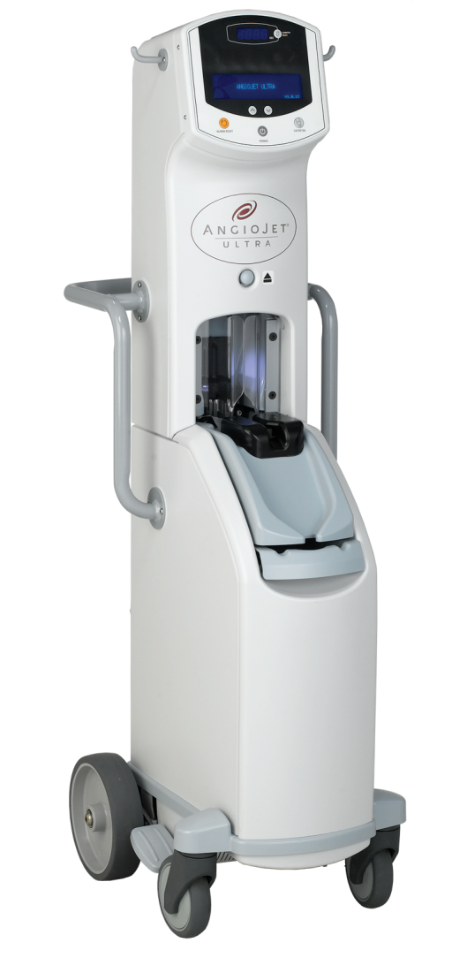
An Option For DVT thrombus Removal
ANGIOJET™ ULTRA Thrombectomy System
MECHANISM OF ACTION
The AngioJet Ultra Console monitors and controls the system.
The Console energizes the pump which sends pressurized saline to the catheter tip.
Saline Jets travel backwards to create a low pressure zone causing a vacuum effect.
4. Thrombus is drawn into the in-flow windows and the jets push the thrombus back down the catheter.
5. Thrombus is evacuated from the body and into the collection bag.
17

Slide 18
Thrombus Removal Is Indicated With Data Showing Benefit
PEARL Registry data demonstrates that mechanical thrombectomy treatment of DVT is safe and effective and can potentially reduce the need for concomitant catheter directed lytic and intensive care stay.
18
The PEARL Registry looked at 371 DVT patients treated using an interventional approach

Slide 19
The Data Behind Thrombus Removal
Outcomes – Interventional Approach To Remove DVT Thrombus
97% had venographic improvement
84% had freedom from re-thrombosis at 1 year
Improved quality of life score for mental and physician baseline out to 1year
Patients treated: 67% acute, 19% sub-acute and 14% Chronic thrombus age
Bleeding complication rate was 4.5%, however not related to the use of AngioJet
19
The PEARL Registry looked at 371 DVT patients treated using an interventional approach

Slide 20
There Is An Indication And Data Behind Thrombus Removal
Using an interventional approach for DVT results showed
Overall, 75% cases completed in < 24 hours
38% of DVT treatment times were completed in < 6 hours
87% had two or less interventional treatments
20
The PEARL Registry looked at 371 DVT patients treated using an interventional approach

Slide 21
Deep Vein Thrombosis Diagnosis
Diagnose deep vein thrombosis (DVT) based on medical history, a physical exam, and test results
Evaluate medical history and risks (Wells Score)
Physical exam - check your legs for signs of DVT, swelling or redness
Diagnostic testing – completing a D-Dimer test
Complete an Ultrasound, CT or MRI
If positive for DVT we encourage you to request a consult to evaluate all treatment options

Slide 22
Moving Forward For Improved Treatment of DVT
Consults available for your patients that have developed a DVT
Offer a multidisciplinary team approach to treating DVT
Create a best practice model
Develop treatment pathways to benefit patients for quicker recovery
Reduce the potential risks for those that develop DVT
Decrease hospital stay and cost associated with DVT
Potential to improve short- and long-term outcomes
22

Slide 23
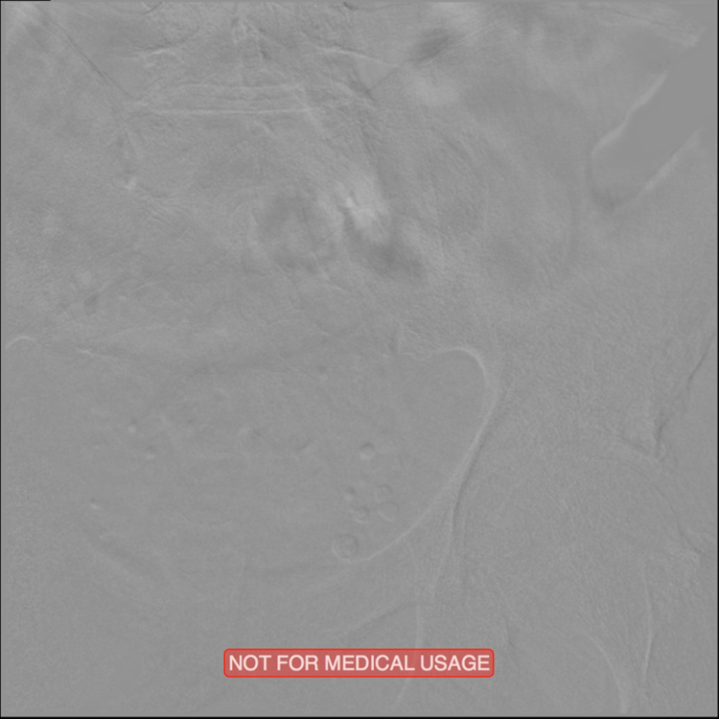
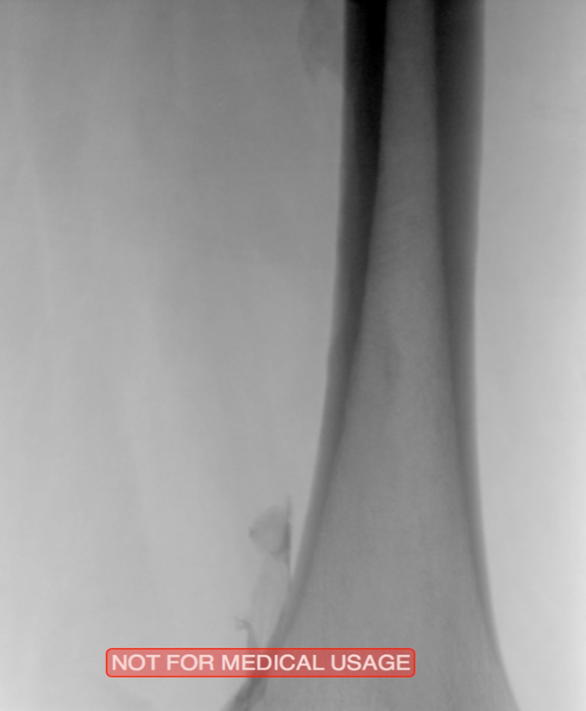
Case Study 1: Extensive DVT of the Right Common Femoral and External Iliac. Treated with ZelanteDVT AngioJet Thrombectomy
Patient History:
73 year old with 1-week old right leg swelling and pain. Started on anticoagulation and discharged. Consult confirmed extensive DVT from Popliteal extending into External Iliac Vein
Occlusive Thrombus Extending Into the Iliac Vein
Femoral Vein Pre-treatment
Images courtesy of Jeffrey Y. Wang, MD FACS, Vascular Surgeon; Horizon Vascular Specialist, Maryland. November, 2015
Results from case studies are not necessarily predictive of results in other cases. Results in other cases may vary.

Slide 24
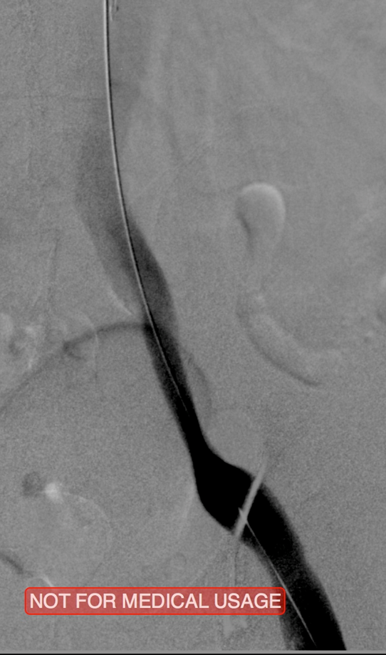
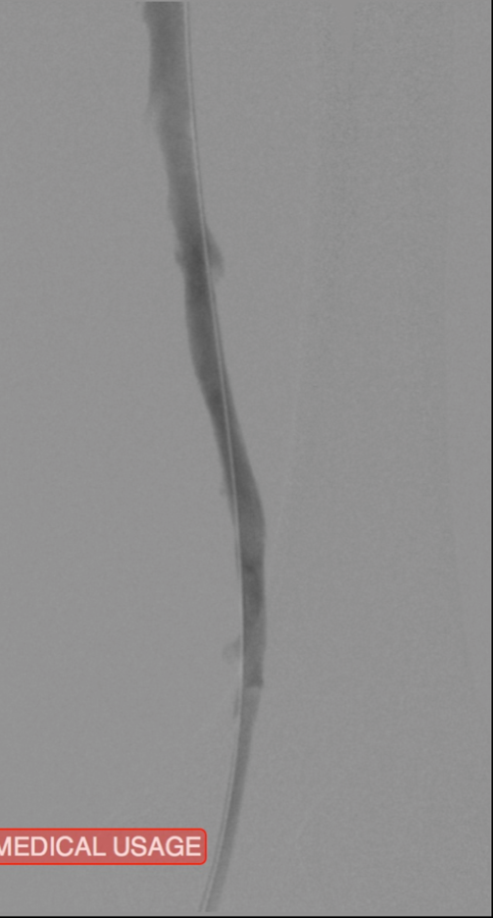
Case Study 1: Post-Treatment Results with 8 F ZelanteDVT™ Catheter
Procedural Steps:
PowerPulse ( tPA 10 mg in 50 cc)
Patient put on 2-hour lytic catheter drip in holding area
Thrombectomy performed with 8F ZelanteDVT catheter
Directional ability of ZelanteDVT allowed targeting of residual thrombus in Popliteal and Superficial Femoral Vein Post Venography shows complete resolution of thrombus
Iliac Vein Post ZelanteDVT
Iliac Vein
Post PTA & Stent
Femoral Vein Post ZelanteDVT
Images courtesy of Jeffrey Y. Wang, MD FACS, Vascular Surgeon; Horizon Vascular Specialist, Maryland. November, 2015
No Stent is FDA-approved for use in the iliac vein
Results from case studies are not necessarily predictive of results in other cases. Results in other cases may vary.

Slide 25
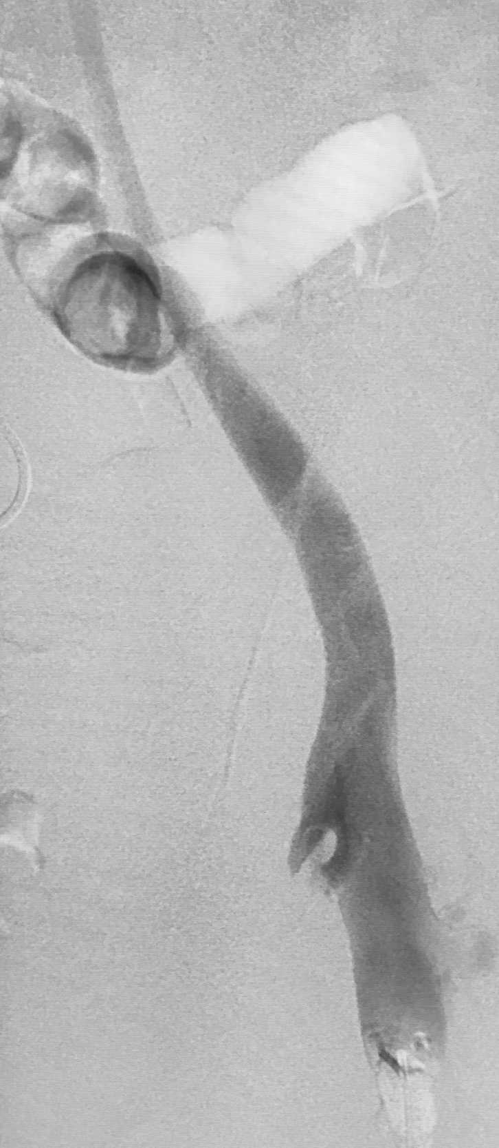
Case Study 2: Acute DVT Left Lower Extremity Revascularization 47 y/o male presented with leg swelling ~2 weeks
IVC Filter placed
Power Pulse™ delivery of 10mg tPA followed by 20 minute dwell time
Acute Iliofemoral Thrombus Pre-treament
Case images courtesy of David Wilson M.D. – Harbin Clinic, Rome, Georgia– December 19, 2015
Post ZelanteDVT™ Pharmacomechanical Thrombectomy
Total runtime was 300 seconds
Results from case studies are not necessarily predictive of results in other cases. Results in other cases may vary.

Slide 26
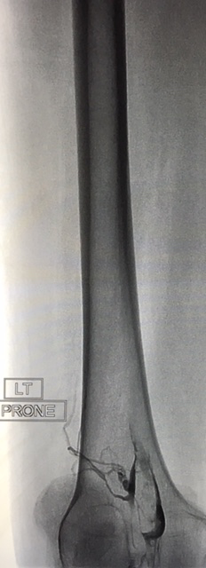
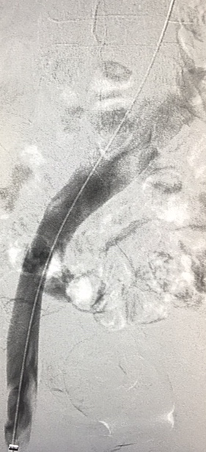
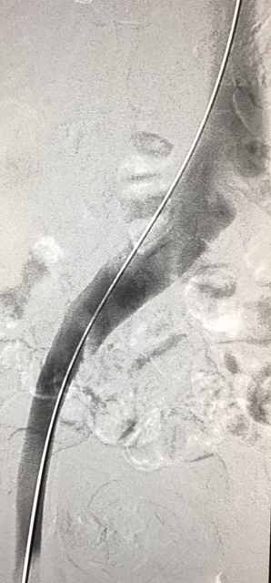
Case Study 3: Pharmacomechanical Revascularization of Extensive IlioFemoral Thrombus
60 y/o female presented with 4 weeks calf pain 1 week swelling
IVC Filter Placed
Post Left
Post Left
Iliofemoral thrombus pre-treatment
Power Pulse™ delivery 10mg tPA, followed by 20 minute dwell time
Post ZelanteDVT™ Mechanical Thrombectomy
ZelanteDVT runtime 415 seconds
Total case time 90 minutes
Images Courtesy of Charles Wyble M.D. – Vascular Surgical Associates, Marietta, Georgia–January 5, 2016
Results from case studies are not necessarily predictive of results in other cases. Results in other cases may vary.

Slide 27
ZelanteDVT™ Thrombectomy Set — Abbreviated Statement
Results from case studies are not necessarily predictive of results in other cases. Results in other cases may vary.
CAUTION: Federal law (USA) restricts this device to sale by or on the order of a physician. Rx only. Prior to use, please see the complete “Instructions for Use” for more information on Indications, Contraindications, Warnings, Precautions, Adverse Events, and Operator’s Instructions.
INDICATIONS AND USAGE
The ZelanteDVT Thrombectomy Set is intended for use with the AngioJet Ultra Console to break apart and remove thrombus, including deep vein thrombus (DVT), from:
• Iliofemoral and lower extremity veins ≥ 6.0 mm in diameter and
• Upper extremity peripheral veins ≥ 6.0 mm in diameter.
The ZelanteDVT Thrombectomy Set is also intended for use with the AngioJet Ultra Power Pulse® technique for the controlled and selective infusion of physician specified fluids, including thrombolytic agents, into the peripheral vascular system.
CONTRAINDICATIONS
Do not use the catheter in patients:
• Who are contraindicated for endovascular procedures
• Who cannot tolerate contrast media
• In whom the lesion cannot be accessed with the guidewire
WARNINGS and PRECAUTIONS
The ZelanteDVT Thrombectomy Set has not been evaluated for treatment of pulmonary embolism. There are reports of serious adverse events, including death, associated with cases where other thrombectomy catheters were used during treatment of pulmonary embolism.
• The ZelanteDVT Thrombectomy Set has not been evaluated for use in the carotid or cerebral vasculature.
• The ZelanteDVT Thrombectomy Set has not been evaluated for use in the coronary vasculature.
• Operation of the catheter may cause embolization of some thrombus and/or thrombotic particulate debris. Debris embolization may cause distal vessel occlusion, which may further result in hypoperfusion or tissue necrosis.
• Cardiac arrhythmias during catheter operation have been reported in a small number of patients. Cardiac rhythm should be monitored during catheter use and appropriate management, such as temporary pacing, be employed, if needed.
• Use of the catheter may cause a vessel dissection or perforation.
• Do not use the AngioJet Ultra System in patients who have a non-healed injury due to recent mechanical intervention, in the vessel to be treated, to avoid further injury, dissection, or hemorrhage.
• Do not use the ZelanteDVT Thrombectomy Set in vessels smaller than minimum vessel diameter as listed in Table 1 of the IFU; such use may increase risk of vessel injury.
AngioJet, ZelanteDVT and PowerPulse are registered or unregistered trademarks of Boston Scientific Corporation or its affiliates. All other trademarks are property of their respective owners.

Slide 28
Questions
Thank you
28

